Slide 1
Image classification &
Bag of tricks
Hosted by-
Aniket Maurya

Slide 2
Agenda
Image Classification with Tensorflow
Learning rate finder
Important points from “Bag of Tricks for Image classification” paper

Slide 3
Training Image Classification Model
Create a CNN
Load your dataset
Preprocess the images
Apply transformations
Batch it
Train
Evaluate

Slide 4
What is this paper about?
Efficient training
Choosing correct batch size
Select learning rate decay
Learning rate warmup
Low precision training and accuracy
Label smoothing

Slide 5
Large Batch Size Training
Large Batch size is used to take advantage of parallelism.
However, for the same number of epochs large batch size leads to degraded validation accuracy.

Slide 6
Linear Scaling the Learning Rate
Large batch size reduces the variance or noise in the gradients.
Choose high lr for large batch size.
If LR for batch size 256 is 0.1 then the generalized lr can be ﻿0.1 × b/256.
credit: deeplearning.ai

Slide 7
Learning Rate warm-up
Initially the network weights are random and Training with a high learning rate can lead to numerical instability.
Training can be started from a very small learning rate and then it can be increased linearly to the initial learning rate.
This process is called learning rate warm-up.

Slide 8
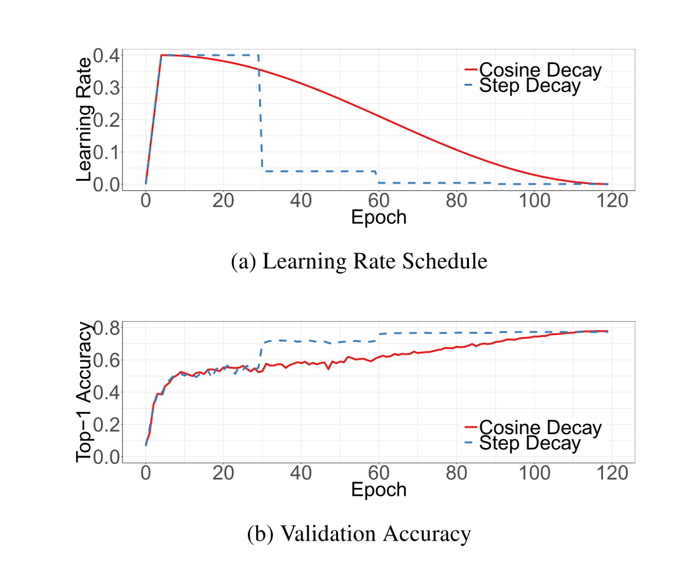
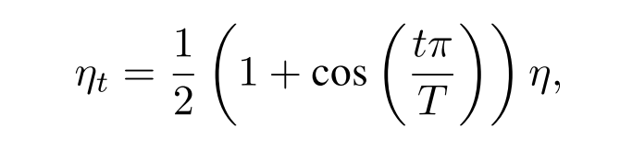
Cosine learning rate decay
In cosine learning rate decay, the learning rate is decayed to 0 by following the cosine function.
T=total num of batches
﻿η = initial learning rate

Slide 9
Mixup

Slide 10
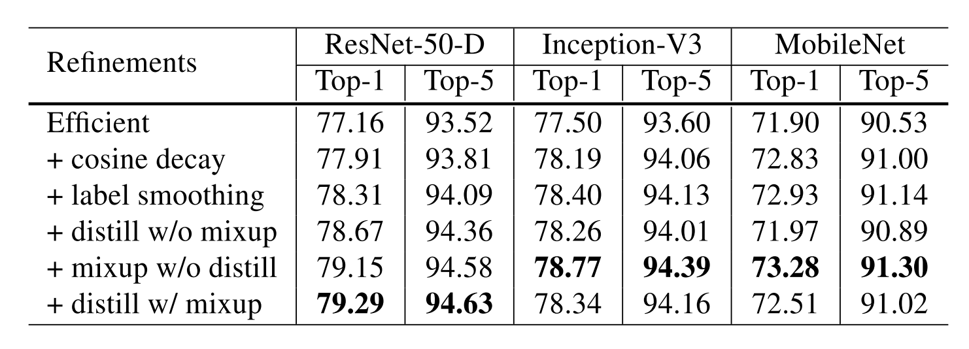

Slide 11

Resources:
Tensorflow LR-finder code
Learning Rate finder blog
Bag of tricks paper

Slide 12

Thank you
https://linkedin.com/in/aniketmaurya
https://twitter.com/aniketmaurya
https://aniketmaurya.ml

